Slide 1
Noise Simulation
Sangyeon Lee
Seoul National Univ.
QDL (Quantum Device LAB. at SNU)
Prof. Eunjong Kim
Date: 2024.01.05

Slide 2
Contents
Physical Noise
Noise Simulation
https://github.com/BrainConnection/QuTiP

Slide 3
Physical Noise

Slide 4
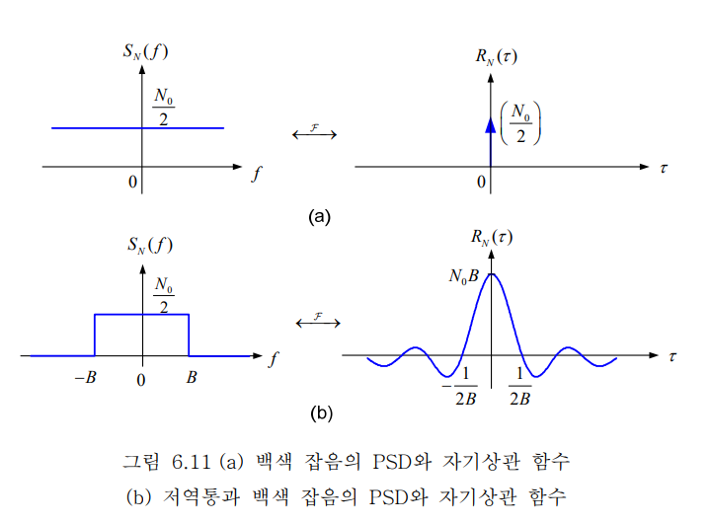
Fourier Transform

Slide 5
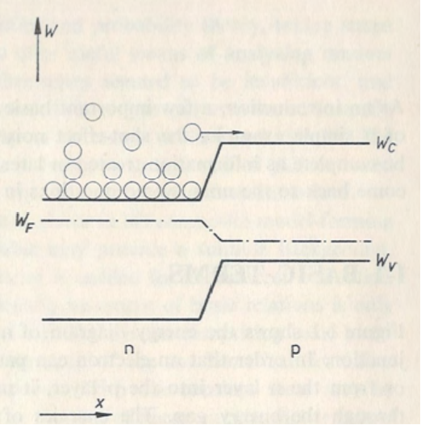
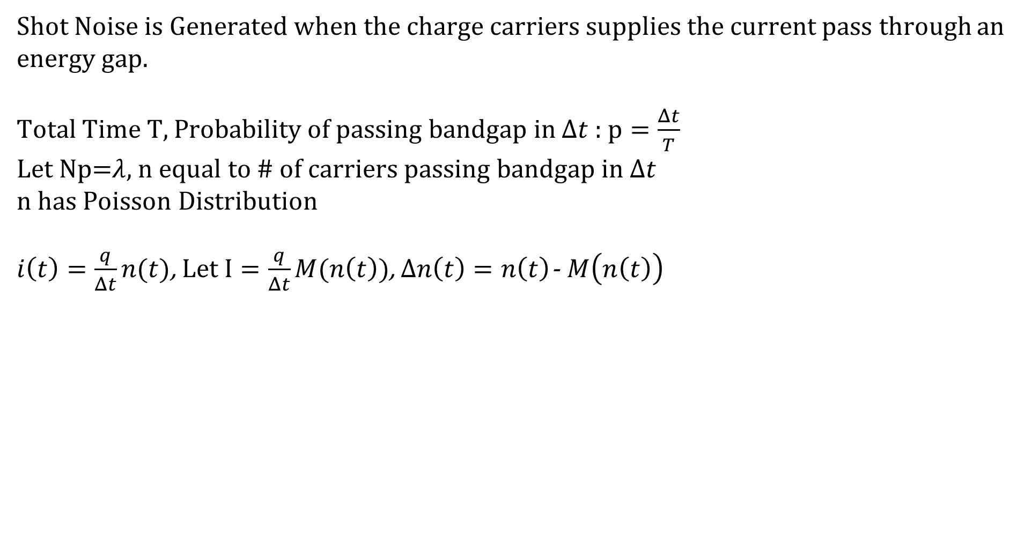
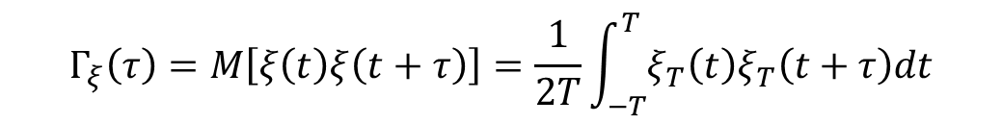
Shot Noise
Shot Noise is Generated when the charge carriers supplies the current pass through an energy gap.
Total Time T, Probability of passing bandgap in $Δt$ : $p=\frac{Δt}{T}$
Let Np=$λ$, n equal to # of carriers passing bandgap in $Δt$
n has Poisson Distribution
$i\left(t\right)=\frac{q}{Δt}n(t)$, Let $I=\frac{q}{Δt}M(n\left(t\right))$, $Δn\left(t\right)=n\left(t\right)$- $M\left(n\left(t\right)\right)$
$$Γ_{ξ}\left(τ\right)=M\left[ξ\left(t\right)ξ\left(t+τ\right)\right]=\frac{1}{2T}\int_{−T}^{T}{ξ_{T}\left(t\right)ξ_{T}\left(t+τ\right)dt}$$

Slide 6
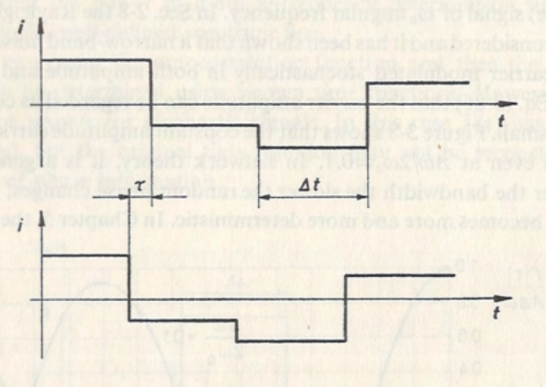
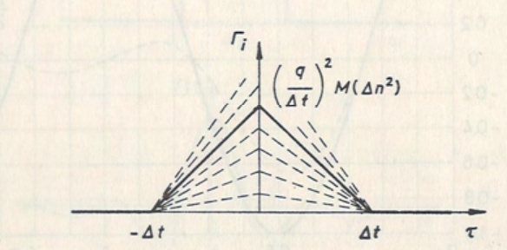
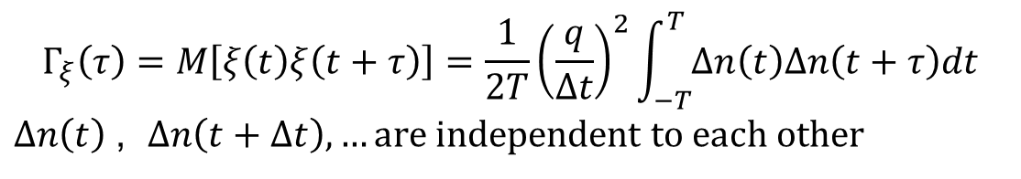

Shot Noise
When $τ$ is over than $Δ$t, Auto Correlation becomes zero.
When $τ$=0, Auto Correlation is maximized.
$Γ\left(τ\right)=M({Δn}^{2})(1−\frac{|τ|}{{Δt}_{0}})$
$s\left(ω\right)=A\frac{\sin^{2}{(\frac{{ωΔt}_{0}}{2})}}{{(\frac{{ωΔt}_{0}}{2})}^{2}}{+B\frac{\sin{(\frac{{ωΔt}_{0}}{2})}}{\frac{{ωΔt}_{0}}{2}}+δ\left(ω\right)}$
$$Γ_{ξ}\left(τ\right)=M\left[ξ\left(t\right)ξ\left(t+τ\right)\right]=\frac{1}{2T}{\left(\frac{q}{Δt}\right)}^{2}\int_{−T}^{T}{Δn\left(t\right)Δn\left(t+τ\right)dt}$$
$Δn\left(t\right)$, $Δn\left(t+Δt\right), …are independent to each other$

Slide 7
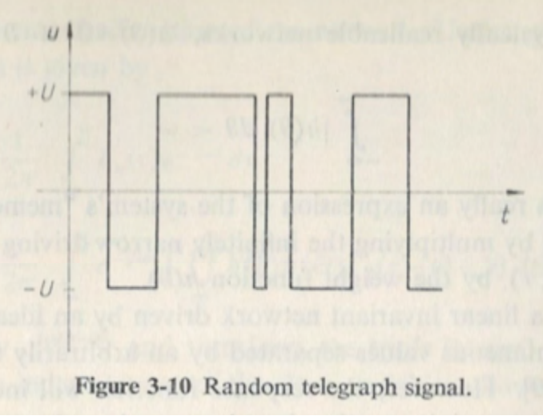

RTN (Random Telegraph Noise)
Random telegraph signal : only have value U, -U
& Change of value follows Poisson distribution
: if signal has v changeovers during unit time,
then probability of having n changeovers during interval $\left(τ\right)$
P(n) = $\frac{{\left(vτ\right)}^{n}}{n!}e^{−vτ}$

Slide 8
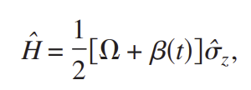


RTN (Random Telegraph Noise)
$Γ\left(τ\right)=M(ξ\left(t\right)ξ\left(t+τ\right))$
Product can only be $±U^{2}$, n even: positive / n odd: negative
$Γ\left(τ\right)=M\left(ξ\left(t\right)ξ\left(t+τ\right)\right)=U^{2}×\text{P}\text{(}\text{n} \text{even}\text{)}\text{ -}{ U}^{2}×\text{P}\text{(}\text{n} \text{odd}\text{)}$
$=U^{2}e^{−2vτ}$
$s\left(ω\right)=\frac{{4U}^{2}v}{{4v}^{2}+ω^{2}}$ ????????
Qubit’s energy gap noise : RTN
How to enhance dephasing time in superconducting qubits
Łukasz Cywiński, Roman M. Lutchyn, Cody P. Nave, and S. Das Sarma
Phys. Rev. B 77, 174509 – Published 13 May 2008

Slide 9
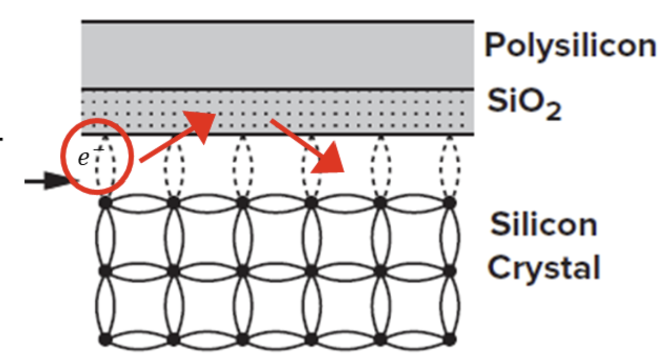

Flicker Noise
At MOSFET…
When Carrier meet trap like dangling bond,
Trapped time distribution of Carrier can be
modeled to
$Δt={Δt}_{0}e^{−\frac{t}{τ}}$
delay time that dangling bond react applied signal difference
like surface voltage… etc
$s\left(ω\right)=C{\frac{I^{β}}{w^{α}}} , α≅1,β≅2$

Slide 10
Noise Simulation

Slide 11
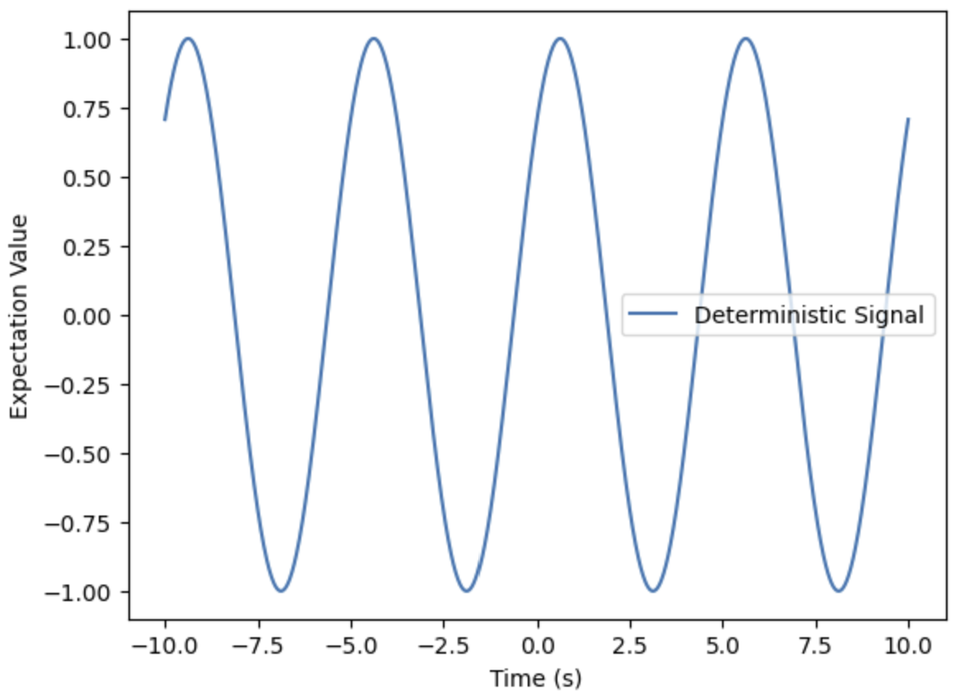
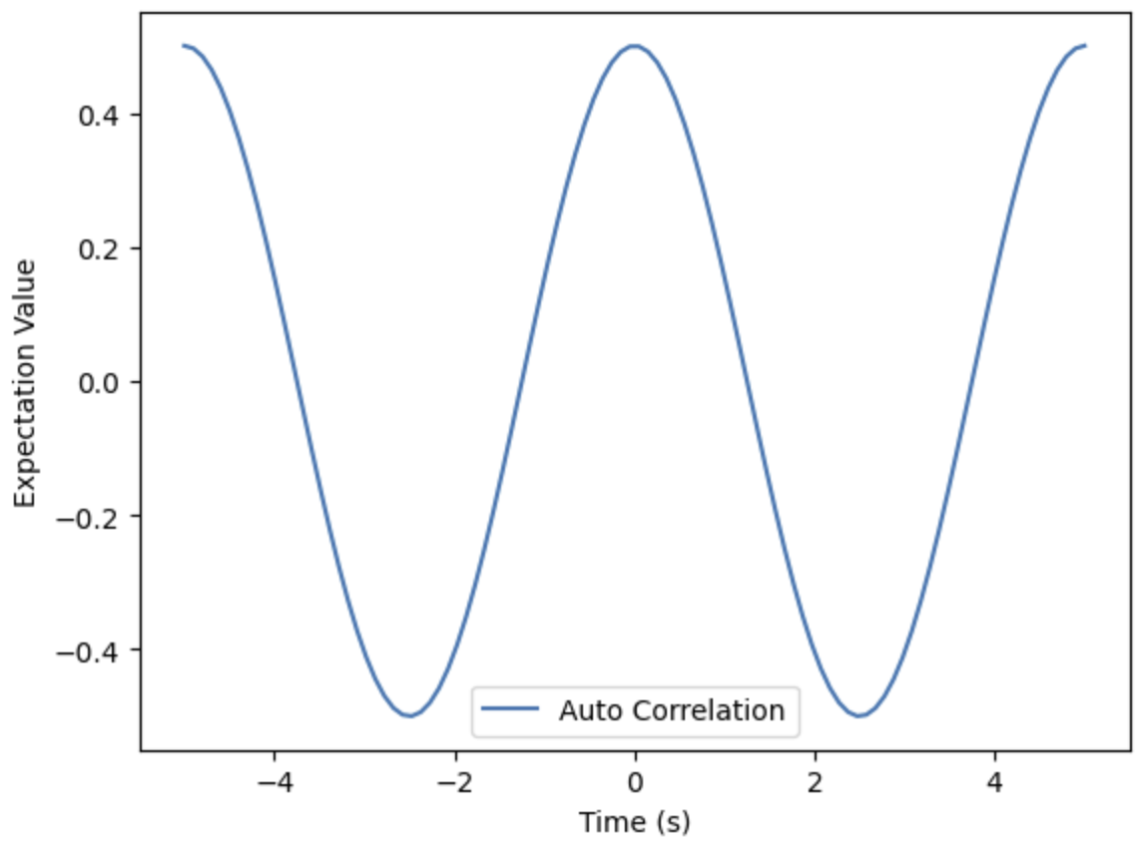
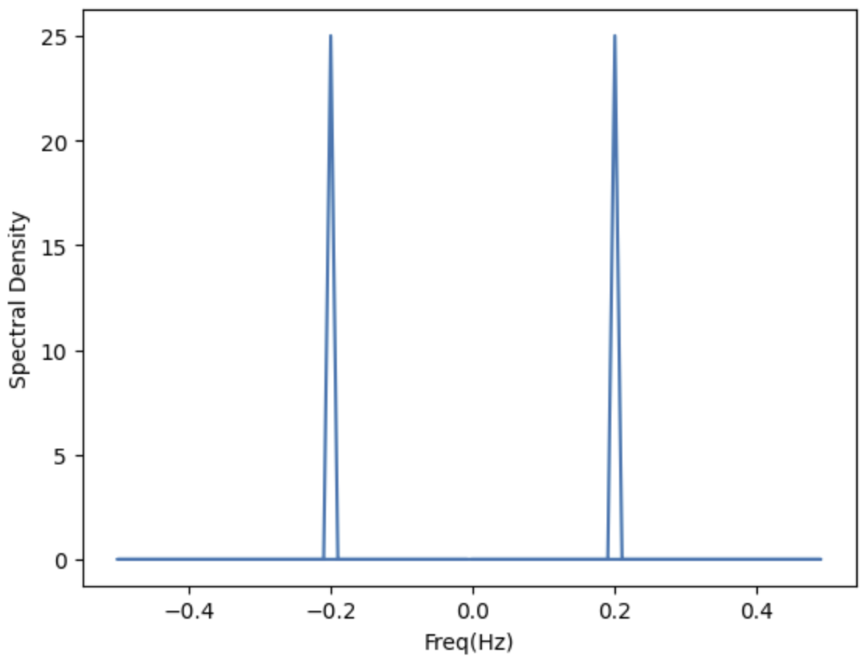

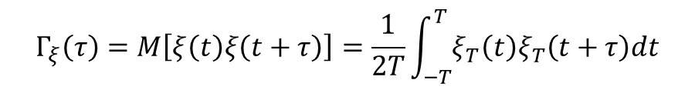
Noise Simulation
$$Γ_{ξ}\left(τ\right)=M\left[ξ\left(t\right)ξ\left(t+τ\right)\right]=\frac{1}{2T}\int_{−T}^{T}{ξ_{T}\left(t\right)ξ_{T}\left(t+τ\right)dt}$$
Deterministic & Periodic Signal
$u\left(t\right)=Usin{{(ω}_{0}t+φ)}$ $Γ\left(τ\right)=\frac{U^{2}}{2}cos{{(ω}_{0}τ)}$ $s\left(ω\right)=\frac{U^{2}}{2}{\frac{δ\left(ω−ω_{0}\right)+δ\left(ω+ω_{0}\right)}{2}}$

Slide 12
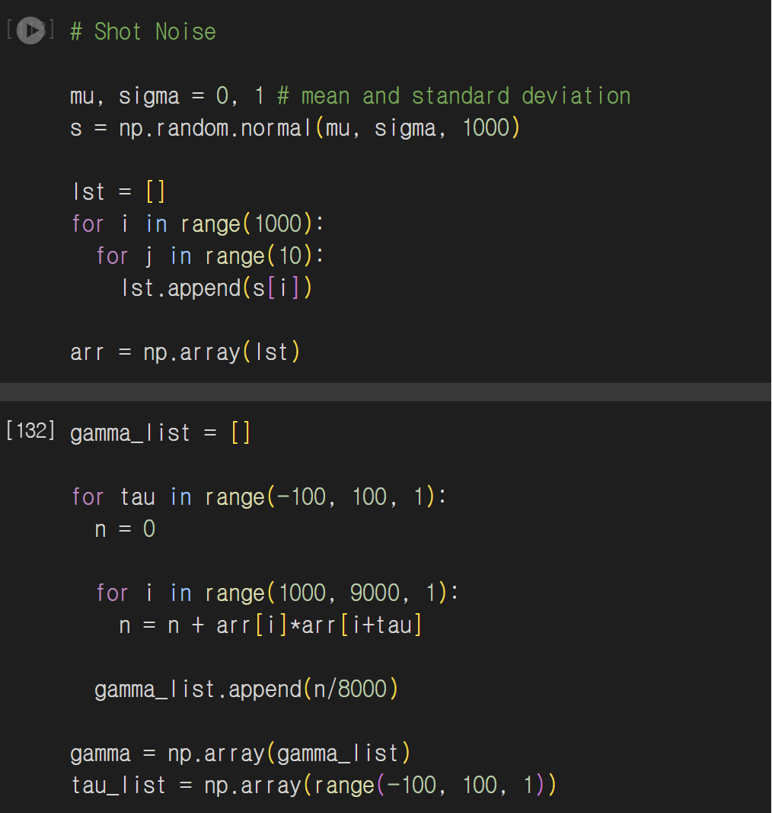
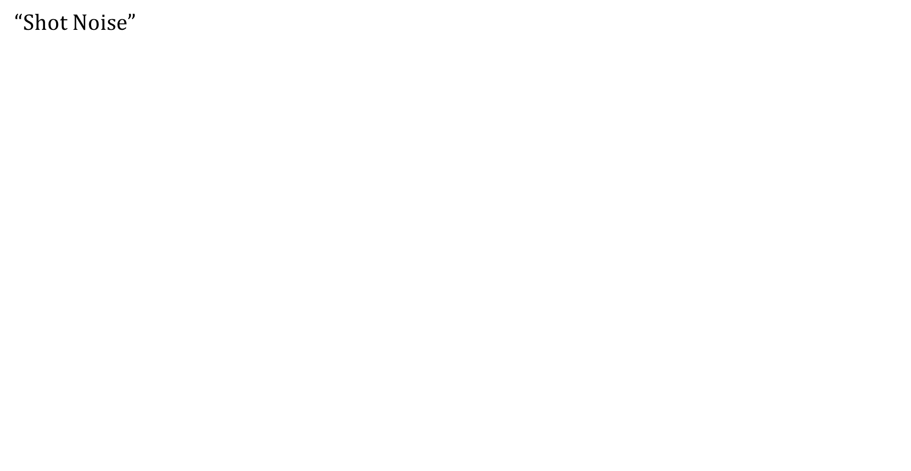
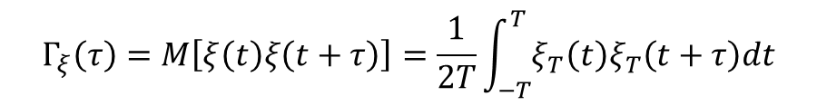
Noise Simulation
“Shot Noise”
$$Γ_{ξ}\left(τ\right)=M\left[ξ\left(t\right)ξ\left(t+τ\right)\right]=\frac{1}{2T}\int_{−T}^{T}{ξ_{T}\left(t\right)ξ_{T}\left(t+τ\right)dt}$$

Slide 13
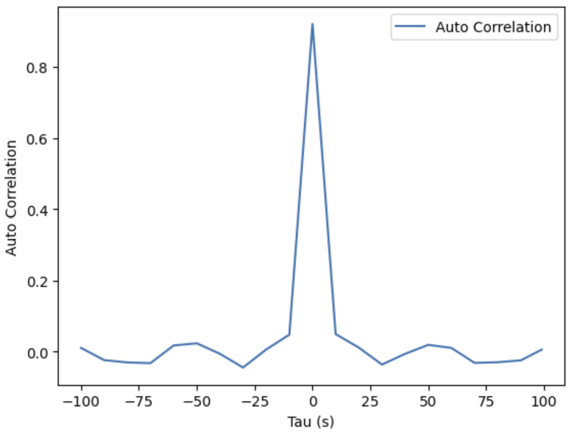
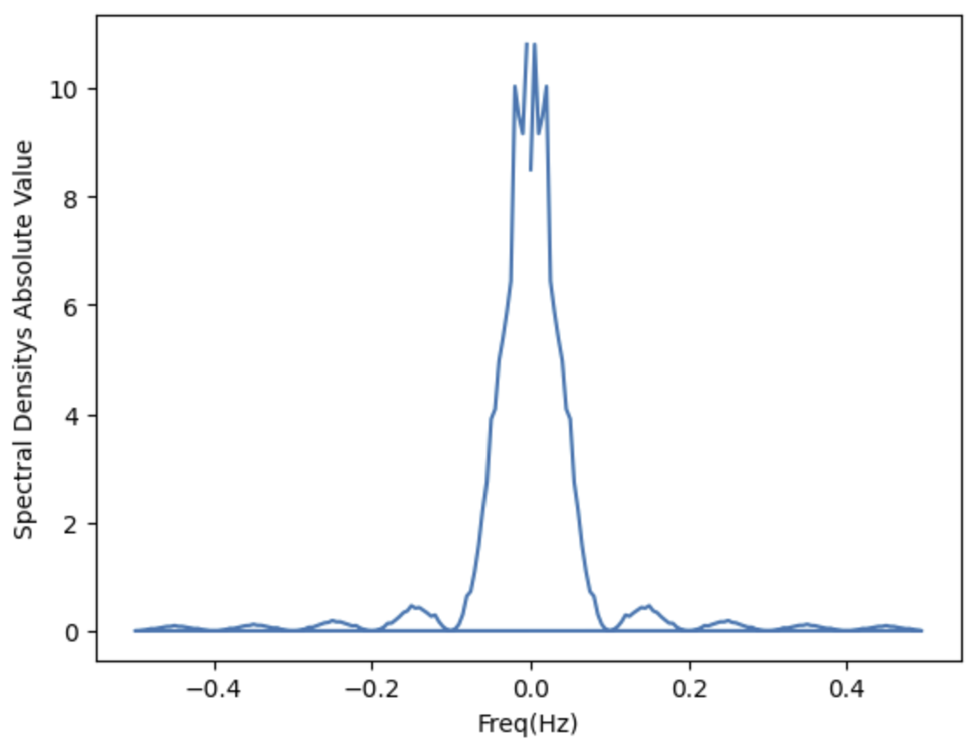

Noise Simulation
“Shot Noise”
$Γ\left(τ\right)=M({Δn}^{2})(1−\frac{|τ|}{{Δt}_{0}})$ $s\left(ω\right)=A\frac{\sin^{2}{(\frac{{ωΔt}_{0}}{2})}}{{(\frac{{ωΔt}_{0}}{2})}^{2}}{+B\frac{\sin{(\frac{{ωΔt}_{0}}{2})}}{\frac{{ωΔt}_{0}}{2}}+δ\left(ω\right)}$

Slide 14
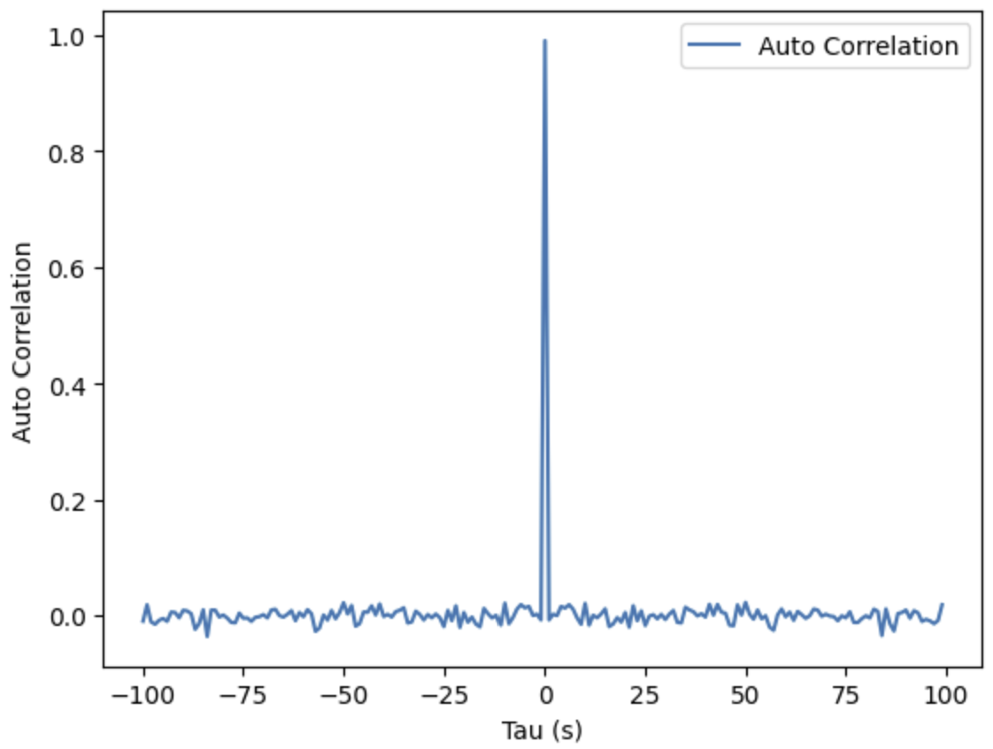
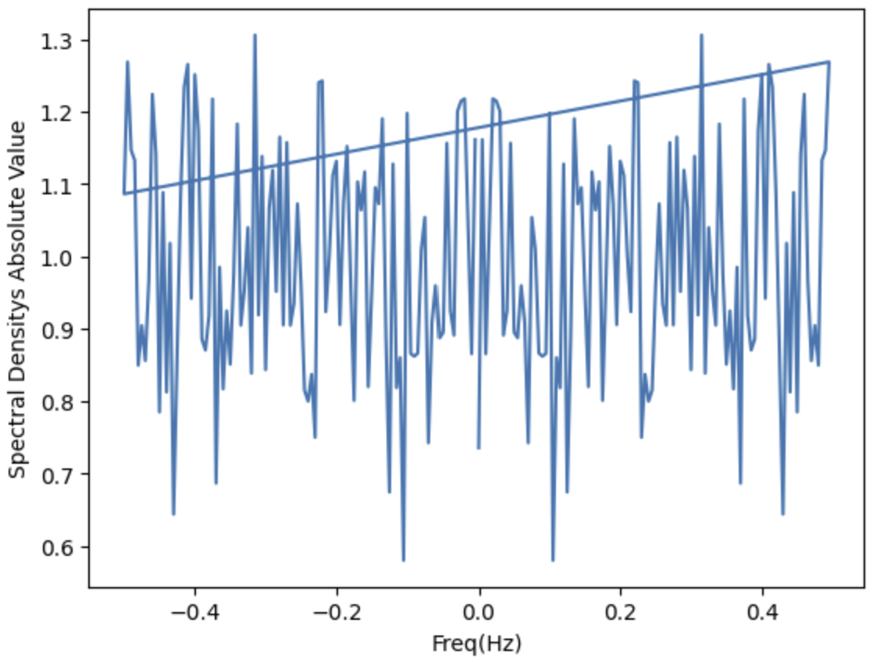

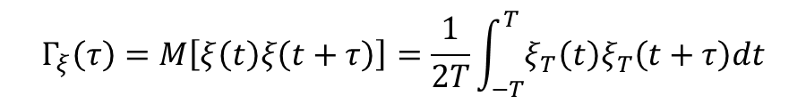
Noise Simulation
$$Γ_{ξ}\left(τ\right)=M\left[ξ\left(t\right)ξ\left(t+τ\right)\right]=\frac{1}{2T}\int_{−T}^{T}{ξ_{T}\left(t\right)ξ_{T}\left(t+τ\right)dt}$$
White Noise
$f\left(x\right)=\frac{1}{σ\sqrt{2π}}{e^{−\frac{1}{2}{\left(\frac{x−μ}{σ}\right)}^{2}},}σ=1,μ=0$ $Γ\left(τ\right)=δ{(τ)}$ $s\left(ω\right)={2π}$

Slide 15
Thank you

